Slide 1
Vision
Kenneth Church
September, 2025

Slide 2
Agenda: Unifying Themes: Scaling, Growth & Collaboration
Macro (Large Market Forces)
Micro (Personal Research)
Who can afford to play?
Narrative: Big companies with deep pockets
DeepSeek showed anyone can contribute
Clouds → Phones
Inference >> Training
Implications for global warming
“Diseconomies of scale”
Peak Data:
Scaling laws break down if we run out of data
Moore’s Law: Everything is getting better
but at different rates → need to rebalance
Should we be more concerned about
supply or demand?
Catch-as-catch-can → Revival of Sampling
Unify LLMs and Linear Algebra
SVD with Batching
Better Together
Academic Search
BERT Embeddings of Papers
Spectral Clustering of Citations
Loss Functions
Entropy: Predict the next word
Nuclear Norm: within → across
Low Resource Languages →
Growth Opportunities
Target languages with future demand
Many speakers and impressive GDP growth

Slide 3
Narrative: Chatbots
Power/Global Warming
Massive Capital Investments
Big AI companies are investing in massive datacenters
Demand for power
is unsustainable
But chat → phones
Only a few huge companies with deep pockets can afford to play
But DeepSeek:
Massive investments →
Massive liabilities

Slide 4
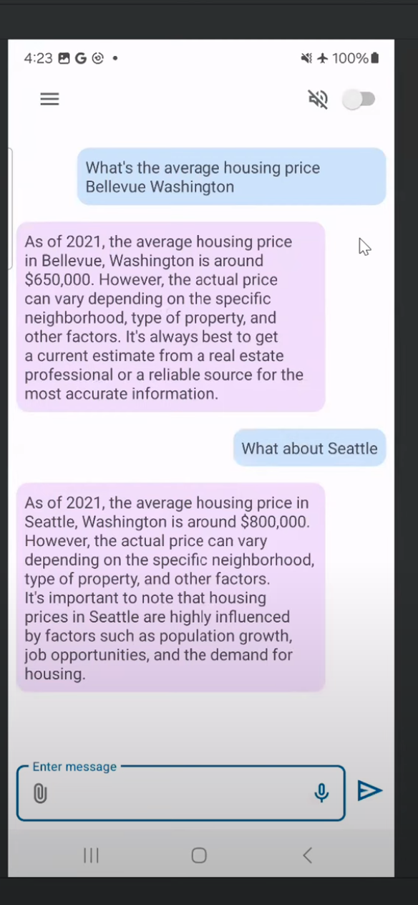

Chat on a phone What’s on the phone, stays on the phone
Phones >> Datacenters
Short-term cost
Long-term cost (Economies of scale)
Latency
Privacy
Power
Weight

Slide 5
Agenda: Unifying Themes: Scaling, Growth & Collaboration
Macro (Large Market Forces)
Micro (Personal Research)
Who can afford to play?
Narrative: Big companies with deep pockets
DeepSeek showed anyone can contribute
Clouds → Phones
Inference >> Training
“Implications for global warming
“Diseconomies of scale”
Peak Data:
Scaling laws break down if we run out of data
Moore’s Law: Everything is getting better
but at different rates → need to rebalance
Should we be more concerned about
supply or demand?
Catch-as-catch-can → Revival of Sampling
Unify LLMs and Linear Algebra
SVD with Batching
Better Together
Academic Search
BERT Embeddings of Papers
Spectral Clustering of Citations
Loss Functions
Entropy: Predict the next word
Nuclear Norm: within → across
Low Resource Languages →
Growth Opportunities
Target languages with future demand
Many speakers and impressive GDP growth

Slide 6
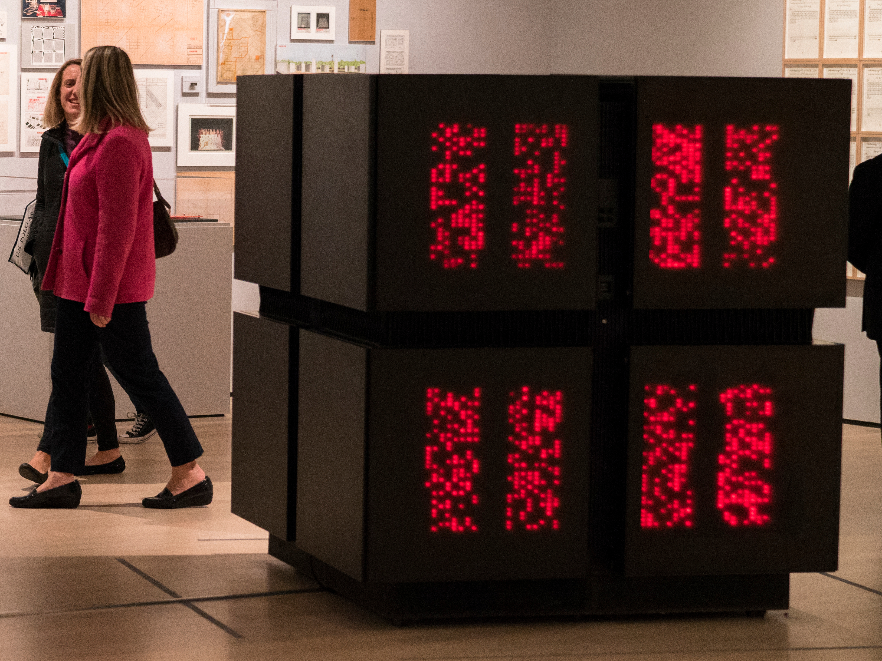
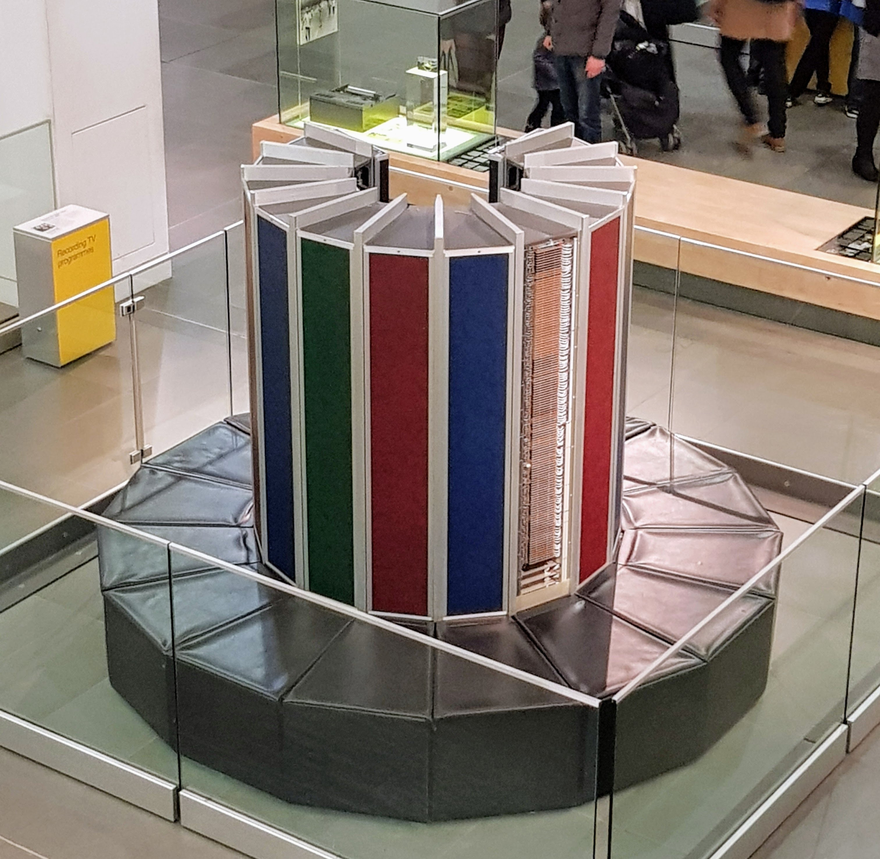
“Diseconomies of Scale”
Scale depends on size of market, not machine; Phones/PCs are bigger than Super-computers
Thinking Machines (CM-2)
Cray-1

Slide 7

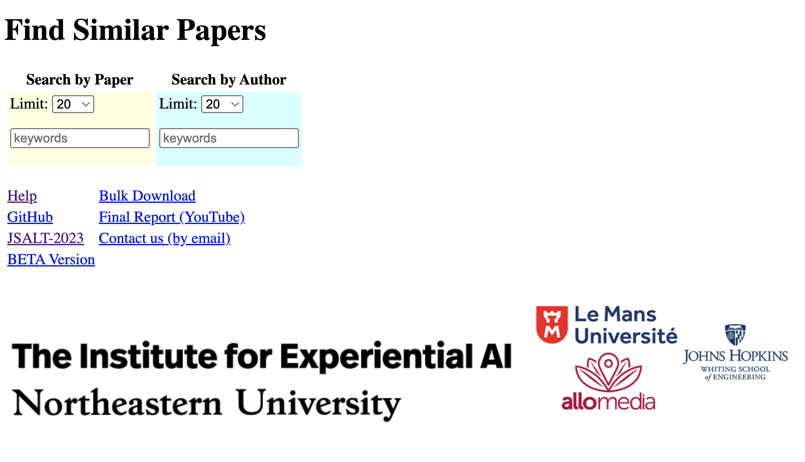
http://recommendpapers.xyz
Academic Search
200M papers
Modest hardware: $1k

Slide 8
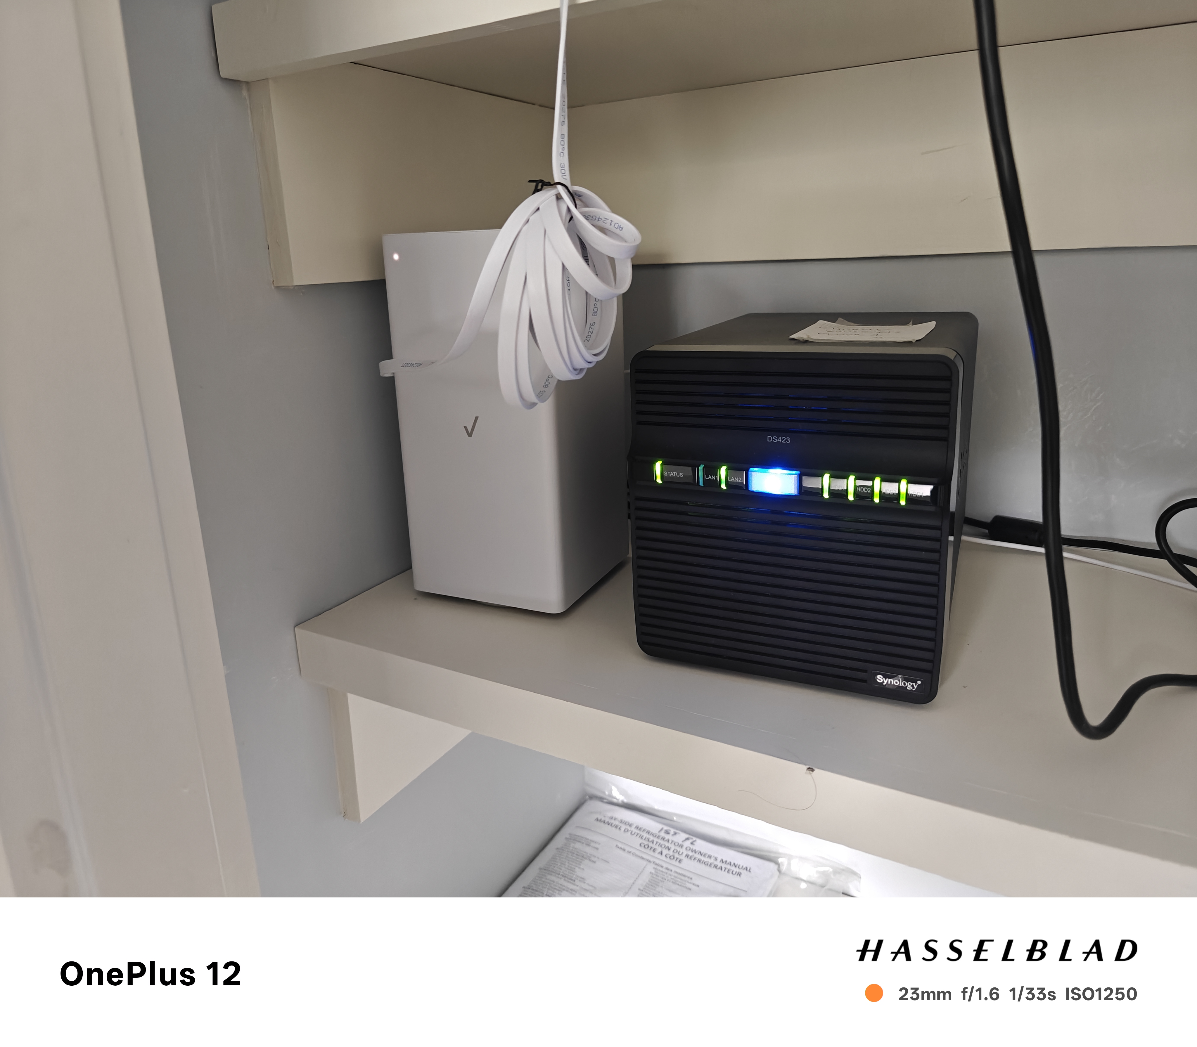
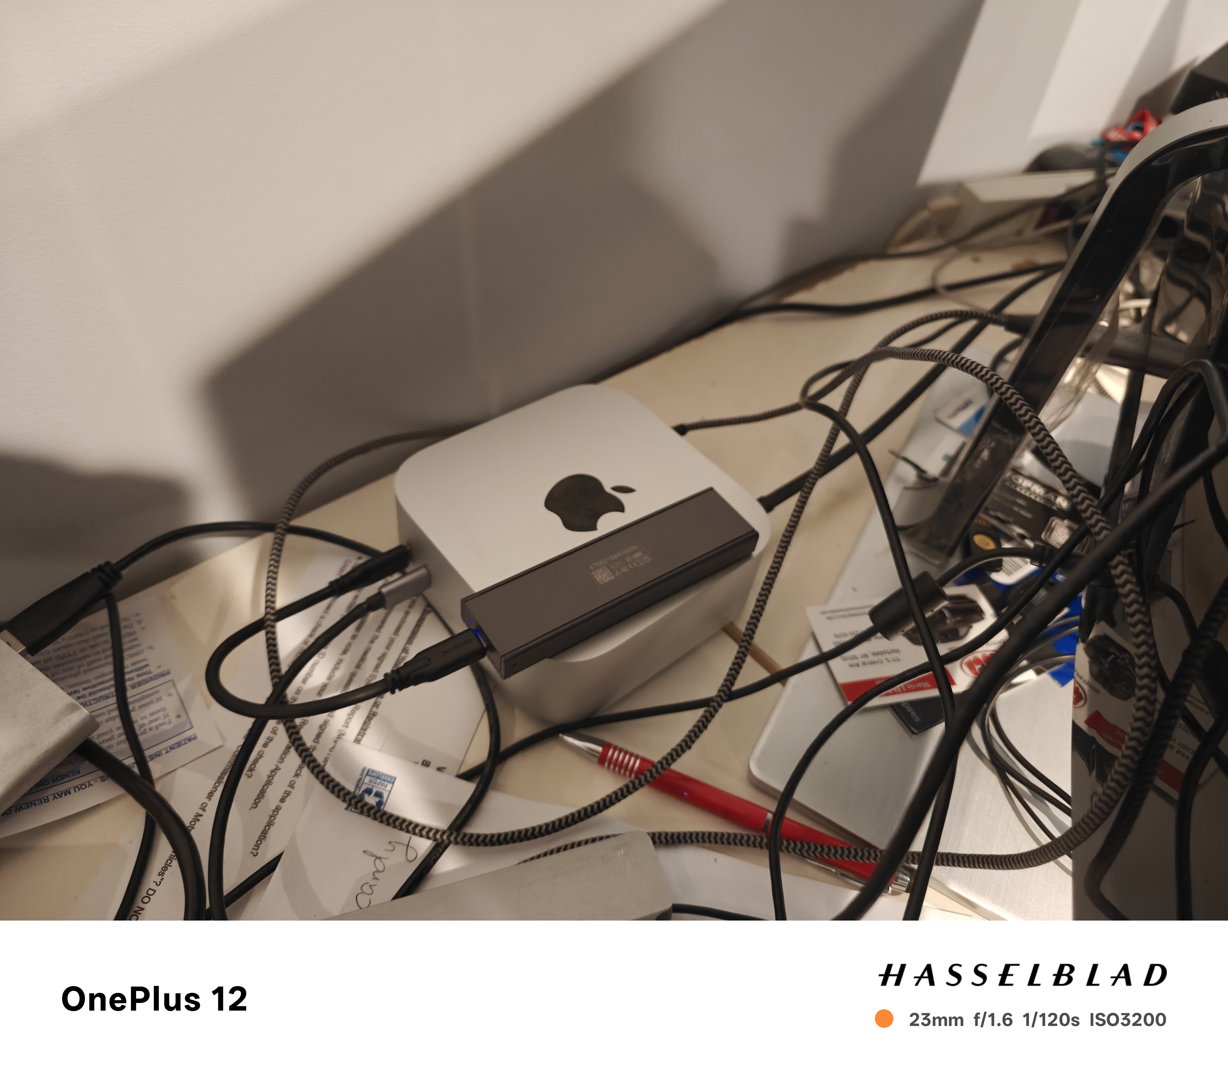
Clouds → Edge (Phones, NAS, etc.) AWS: $276/TB/year
Disk: 68 TBs @ $11/TB
Broadband: 2Gps @ $100/month
SSD: 4TBs @ $60/TB
Scale depends on size of market, not machine; Phones/PCs are bigger than Super-computers/Clouds

Slide 9
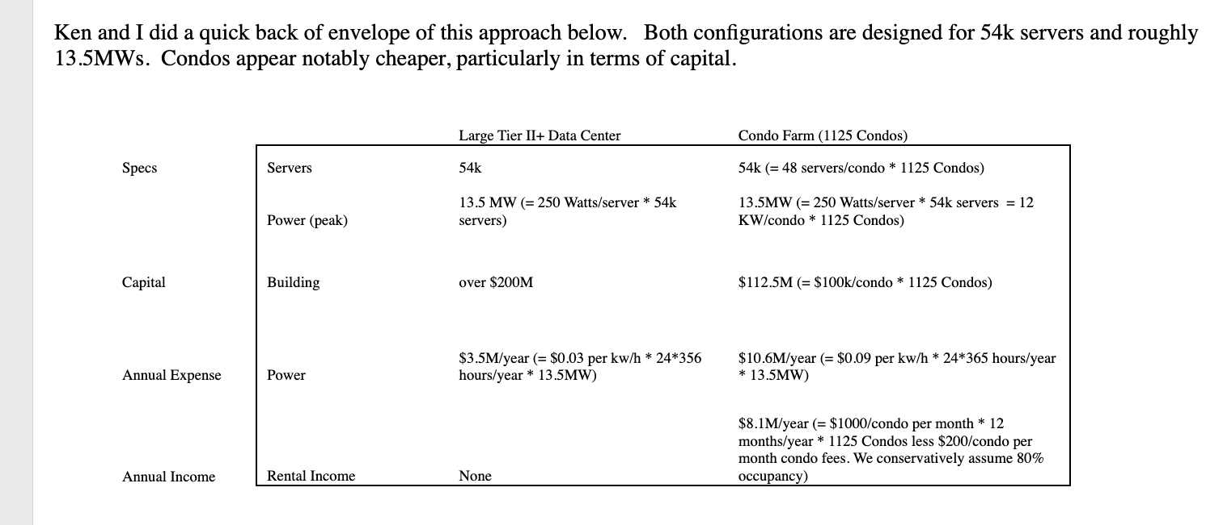

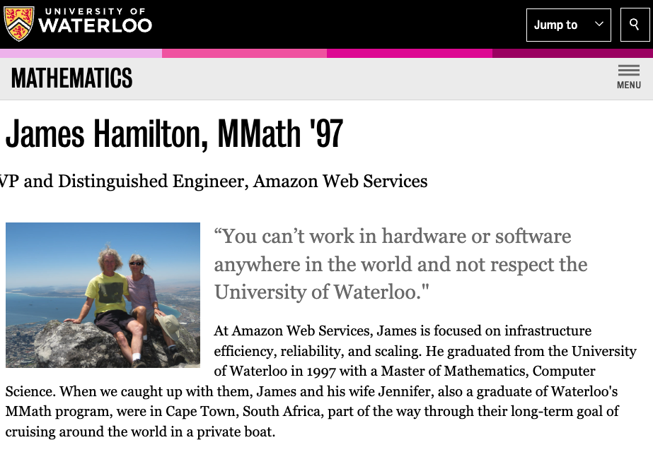
Clouds are Super-Expensive Diseconomies of Scale
http://perspectives.mvdirona.com/2008/04/06/DiseconomiesOfScale.aspx

Slide 10
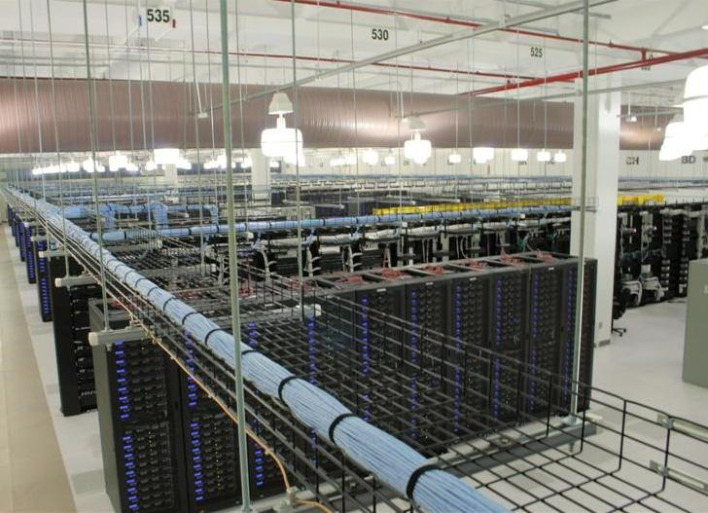
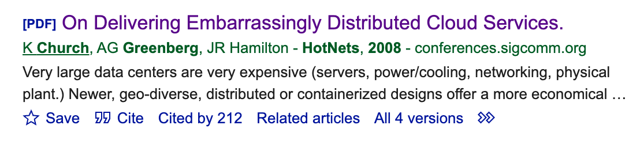
On Delivering Embarrassingly Distributed Cloud Services
Board
Ken Church
Albert Greenberg
James Hamilton
{church, albert, jamesrh}@microsoft.com
Affordable
$1B
$2M

Slide 11
Agenda: Unifying Themes: Scaling, Growth & Collaboration
Macro (Large Market Forces)
Micro (Personal Research)
Who can afford to play?
Narrative: Big companies with deep pockets
DeepSeek showed anyone can contribute
Clouds → Phones
Inference >> Training
“Implications for global warming
“Diseconomies of scale”
Peak Data:
Scaling laws break down if we run out of data
Moore’s Law: Everything is getting better
but at different rates → need to rebalance
Should we be more concerned about
supply or demand?
Unify LLMs and Linear Algebra
SVD with Batching
Better Together
Academic Search
BERT Embeddings of Papers
Spectral Clustering of Citations
Loss Functions
Entropy: Predict the next word
Nuclear Norm: within → across
Low Resource Languages →
Growth Opportunities
Target languages with future demand
Many speakers and impressive GDP growth

Slide 12
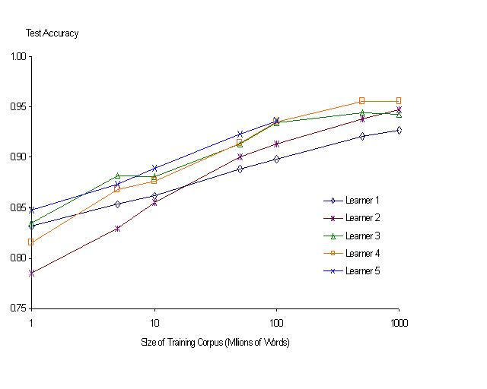
“It never pays to think until you’ve run out of data” – Eric Brill
Moore’s Law Constant:
Data Collection Rates → Improvement Rates
Banko & Brill: Mitigating the Paucity-of-Data Problem (HLT 2001)
No consistently
best learner
There is no data like more data
Quoted out of context
Fire everybody and
spend the money on data

Slide 13
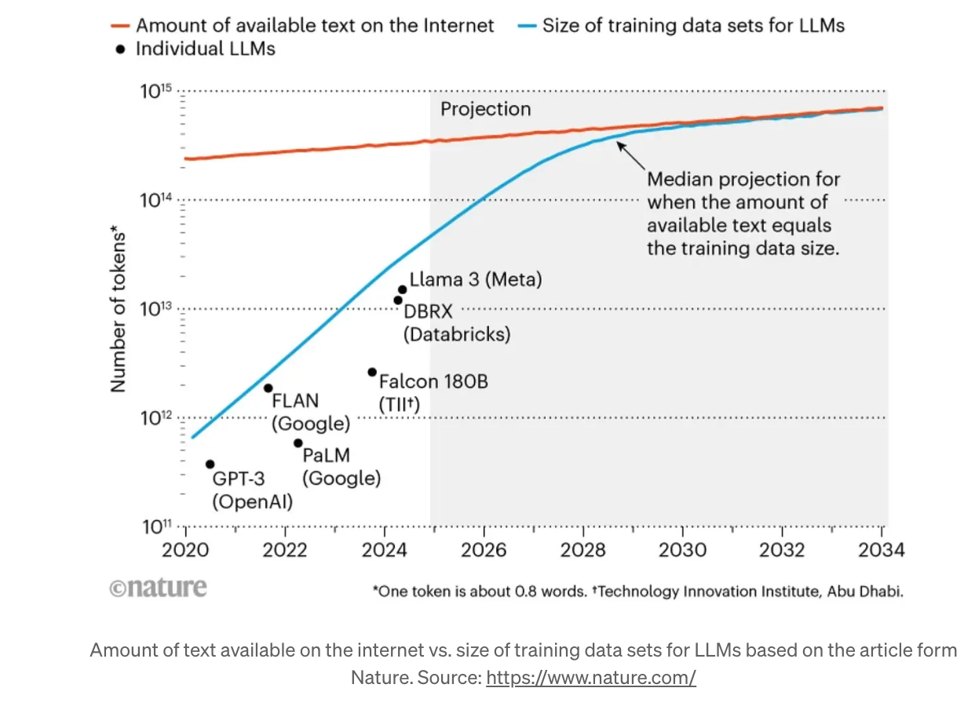
Peak Data: We are running out of data
Suggestion:
Target data sources
like DNA
with more growth
(10k /decade)

Slide 14
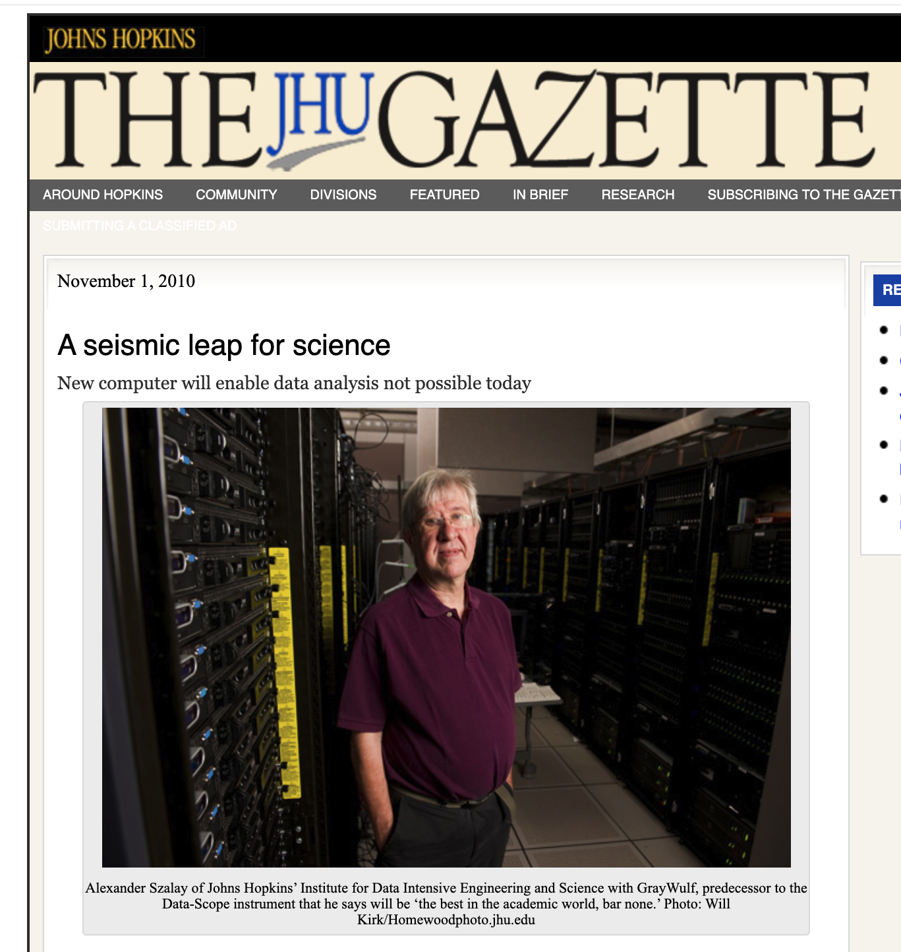
Data Scope
Collaboration with
Alex Szalay (Astronomy)
I was hoping his data would be astronomical
But data in astronomy
are limited by budgets (not universe)
He was hoping speech & language data would be larger
but there is a finite population
with limited time to talk
Doctors at Hopkins suggested DNA
Disks → 1k growth per decade
DNA → 10k growth per decade

Slide 15
Agenda: Unifying Themes: Scaling, Growth & Collaboration
Macro (Large Market Forces)
Micro (Personal Research)
Who can afford to play?
Narrative: Big companies with deep pockets
DeepSeek showed anyone can contribute
Clouds → Phones
Inference >> Training
“Implications for global warming
“Diseconomies of scale”
Peak Data:
Scaling laws break down if we run out of data
Moore’s Law: Everything is getting better
but at different rates → need to rebalance
Should we be more concerned about
supply or demand?
Unify LLMs and Linear Algebra
SVD with Batching
Better Together
Academic Search
BERT Embeddings of Papers
Spectral Clustering of Citations
Loss Functions
Entropy: Predict the next word
Nuclear Norm: within → across
Low Resource Languages →
Growth Opportunities
Target languages with future demand
Many speakers and impressive GDP growth

Slide 16
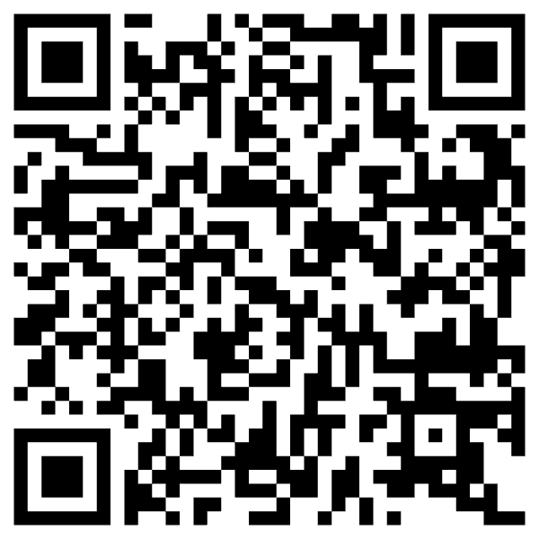
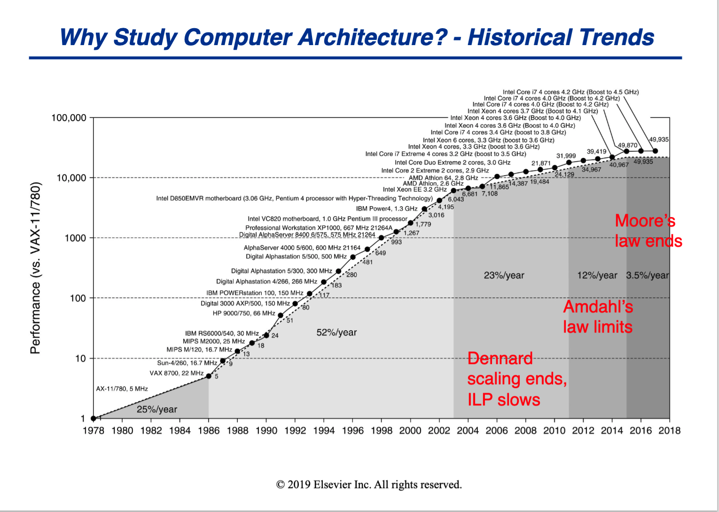
Everything is getting better SPEC Benchmark: 50k speedup over 40 years
https://courses.grainger.illinois.edu/CS433/fa2021/slides/chapter1-part1-post-lecture.pdf

Slide 17
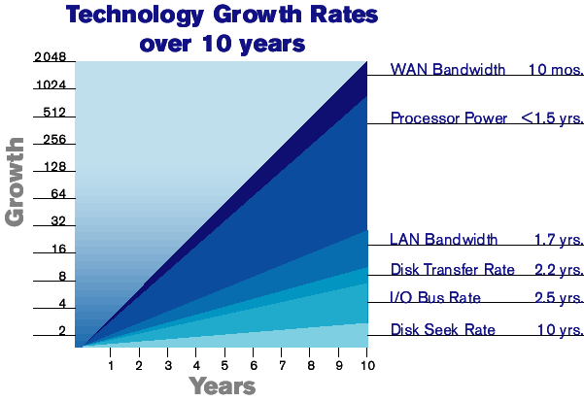
Exponential Improvements Everywhere, But with Different Time Constants
R&D Budget
Physics

Slide 18
Bottlenecks
R&D Budget
(More growth per decade: 100-1000x)
Physics
(Less growth per decade: 1-100x)
Disk Capacity
CPUs
RAM
Disk Seek
Batteries

Slide 19
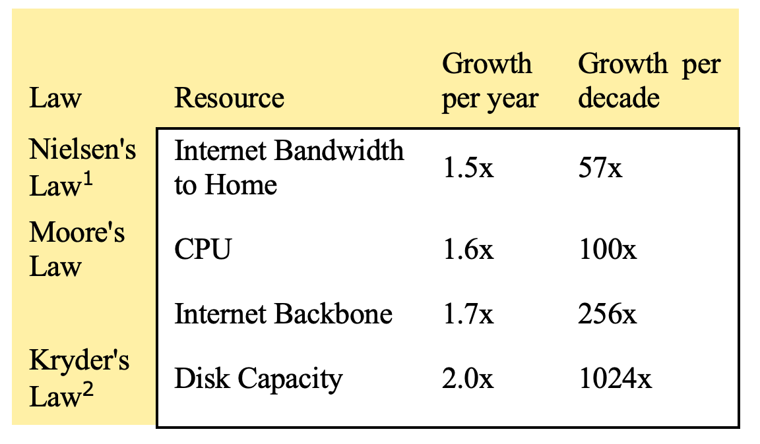
Mobility Gap: Disks >> Bandwidth Different Time Constants → Rebalancing

Slide 20
Agenda: Unifying Themes: Scaling, Growth & Collaboration
Macro (Large Market Forces)
Micro (Personal Research)
Who can afford to play?
Narrative: Big companies with deep pockets
DeepSeek showed anyone can contribute
Clouds → Phones
Inference >> Training
“Implications for global warming
“Diseconomies of scale”
Peak Data:
Scaling laws break down if we run out of data
Moore’s Law: Everything is getting better
but at different rates → need to rebalance
Should we be more concerned about
supply or demand?
Unify LLMs and Linear Algebra
SVD with Batching
Better Together
Academic Search
BERT Embeddings of Papers
Spectral Clustering of Citations
Loss Functions
Entropy: Predict the next word
Nuclear Norm: within → across
Low Resource Languages →
Growth Opportunities
Target languages with future demand
Many speakers and impressive GDP growth

Slide 21
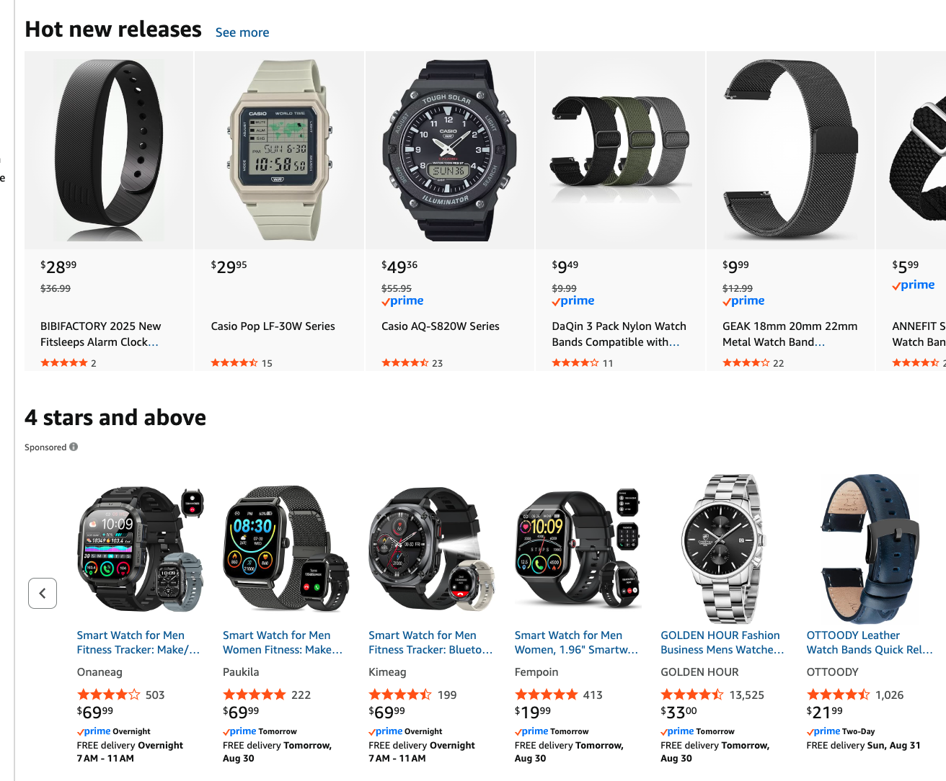
Demand may not keep up with supply Different Time Constants → Rebalancing
Historically, demand has never been a problem
If we build it, they will come
But now that disks cost less than pizza,
will they keep coming?
If you can have all the disk you can eat,
how much would you eat?
Similar arguments apply to memory, cycles, etc.
Recommendation:
Invest in killer apps (like search) that help consumers consume more

Slide 22
Agenda: Unifying Themes: Scaling, Growth & Collaboration
Macro (Large Market Forces)
Micro (Personal Research)
Who can afford to play?
Narrative: Big companies with deep pockets
DeepSeek showed anyone can contribute
Clouds → Phones
Inference >> Training
“Diseconomies of scale”
Implications for global warming
Peak Data:
Scaling laws break down if we run out of data
Moore’s Law: Everything is getting better
but at different rates → need to rebalance
Should we be more concerned about
supply or demand?
Catch-as-catch-can → Revival of Sampling
Unify LLMs and Linear Algebra
SVD with Batching
Better Together
Academic Search
BERT Embeddings of Papers
Spectral Clustering of Citations
Loss Functions
Entropy: Predict the next word
Nuclear Norm: within → across
Low Resource Languages →
Growth Opportunities
Target languages with future demand
Many speakers and impressive GDP growth

Slide 23
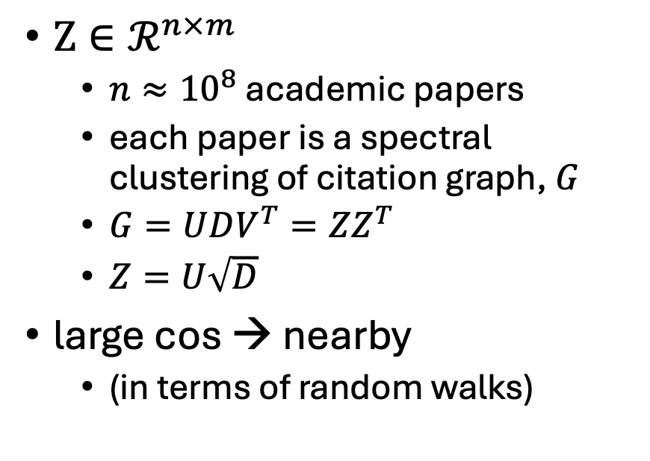
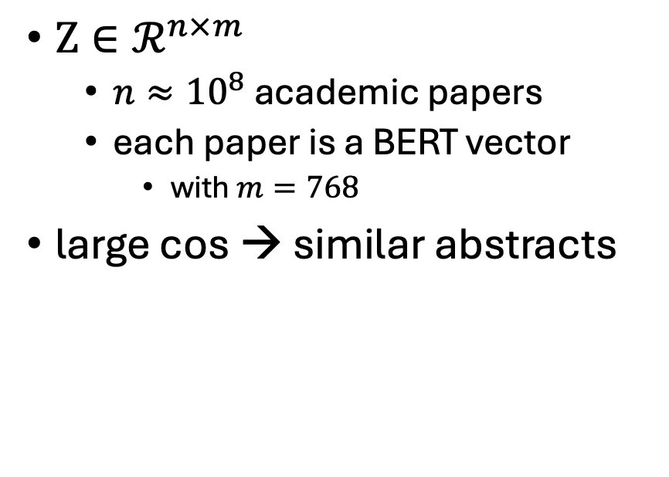
Better Together: Two Different Embeddings
BERT-like Embeddings of Papers
Graph Embeddings of Citations
$Z∈ℛ^{n×m}$
$n≈{10}^{8}$ academic papers
each paper is a BERT vector
with $m=768$
large cos → similar abstracts
$Z∈ℛ^{n×m}$
$n≈{10}^{8}$ academic papers
each paper is a spectral clustering of citation graph, $G$
$G=UDV^{T}=ZZ^{T}$
$Z=U\sqrt{D}$
large cos → nearby
(in terms of random walks)
Generalize to capture random walks

Slide 24
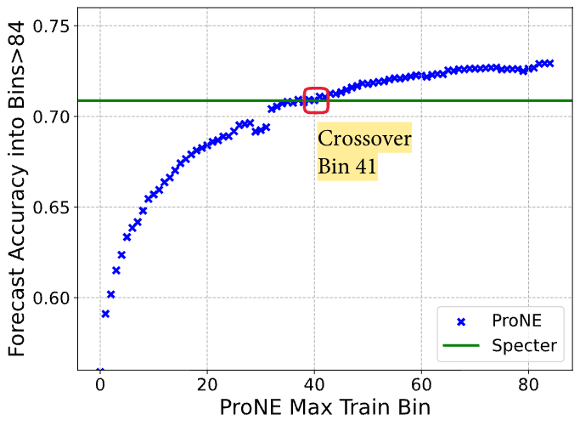
Network Effects Catch-as-catch-can → Revival of Sampling
Larger Graphs → Spectral Clustering
Stratify Benchmark by Size of Graph
Standard Benchmarks
Evaluate a single point (Graph)
Miss network effects
Large Graphs → ProNE (Citations)
Small Graphs → Specter (Abstracts)

Slide 25


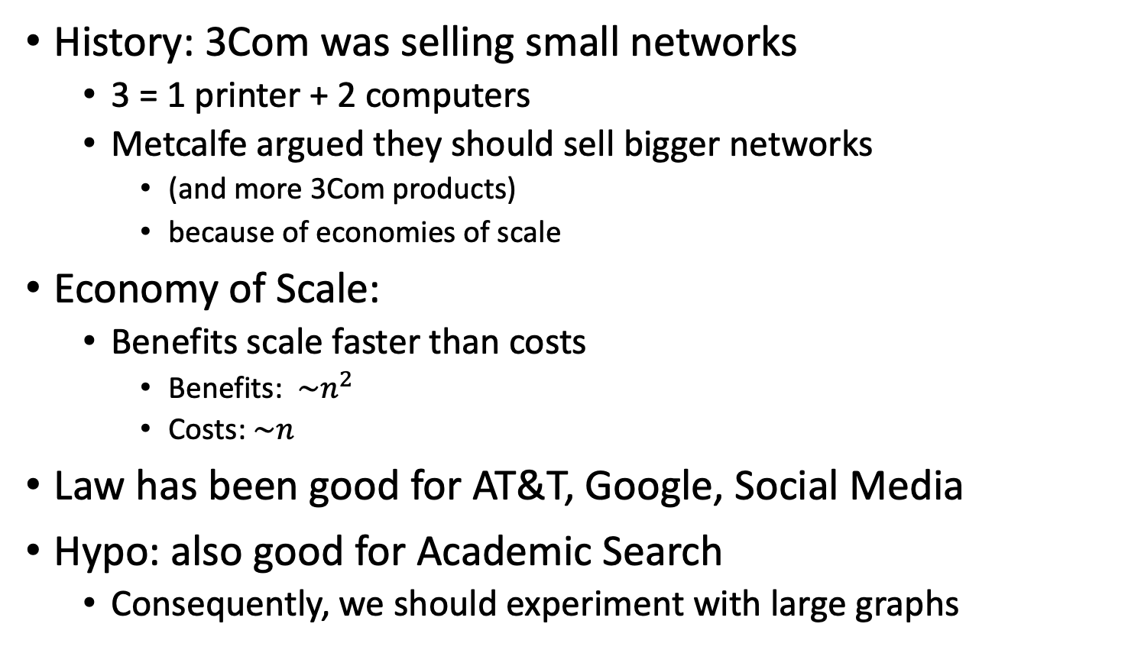
Metcalfe’s Law (Network Effects)
History: 3Com was selling small networks
3 = 1 printer + 2 computers
Metcalfe argued they should sell bigger networks
(and more 3Com products)
because of economies of scale
Economy of Scale:
Benefits scale faster than costs
Benefits: $\sim n^{2}$
Costs:$\sim n$
Law has been good for AT&T, Google, Social Media
Hypo: also good for Academic Search
Consequently, we should experiment with large graphs
Turing Award

Slide 26
My Current Research Catch-as-catch-can → Revival of Sampling
Unify LLMs and Linear Algebra
SVD with Batching
Better Together
Academic Search
BERT Embeddings of Papers
Spectral Clustering of Citations
Loss Functions
Entropy: Predict the next word
Nuclear Norm: within → across
Low Resource Languages →
Growth Opportunities
Target languages with future demand
Many speakers and impressive GDP growth

Slide 27
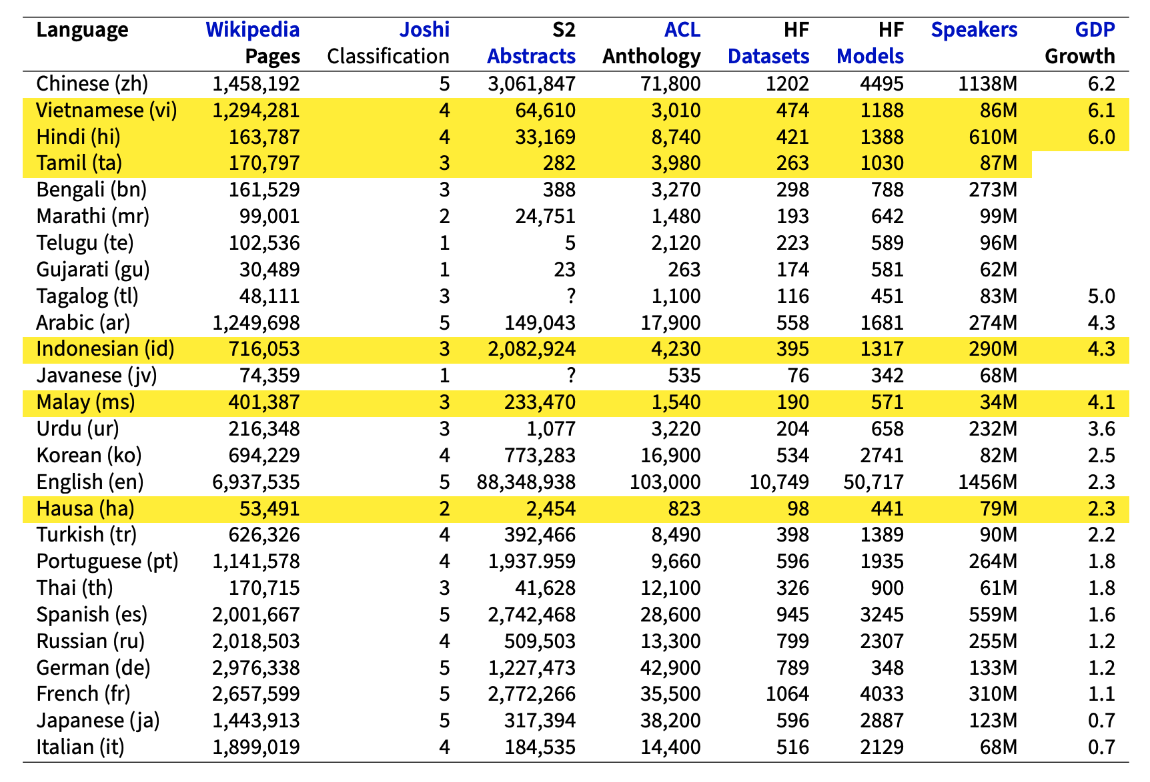
Low Resource Languages → Growth Opportunities Stratify by Resources and Opportunities

Slide 28
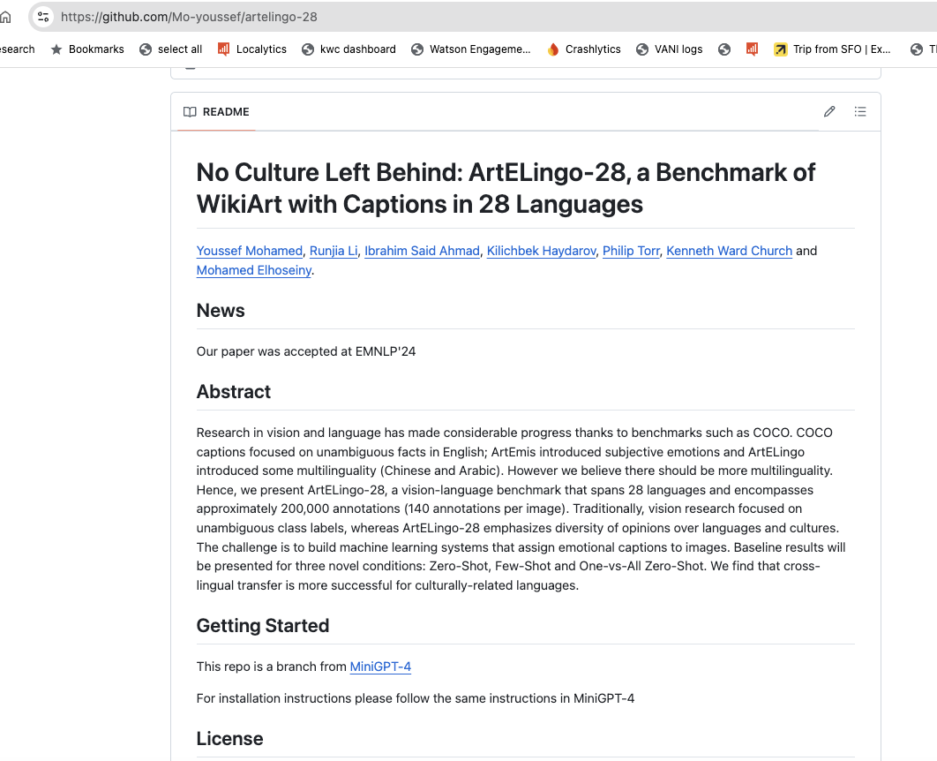


Slide 29
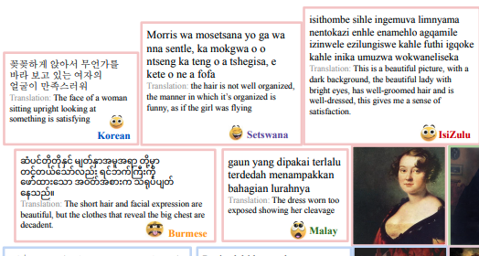
Embrace Diversity & Multiple Perspectives
emotion labels:
disgust (Burmese)
awe (Malay)
captions focus
on chest
Burmese & Malay
on face and hair
Korean & Setswana
Hypothesis:
Predictable
Ethics Review

Slide 30
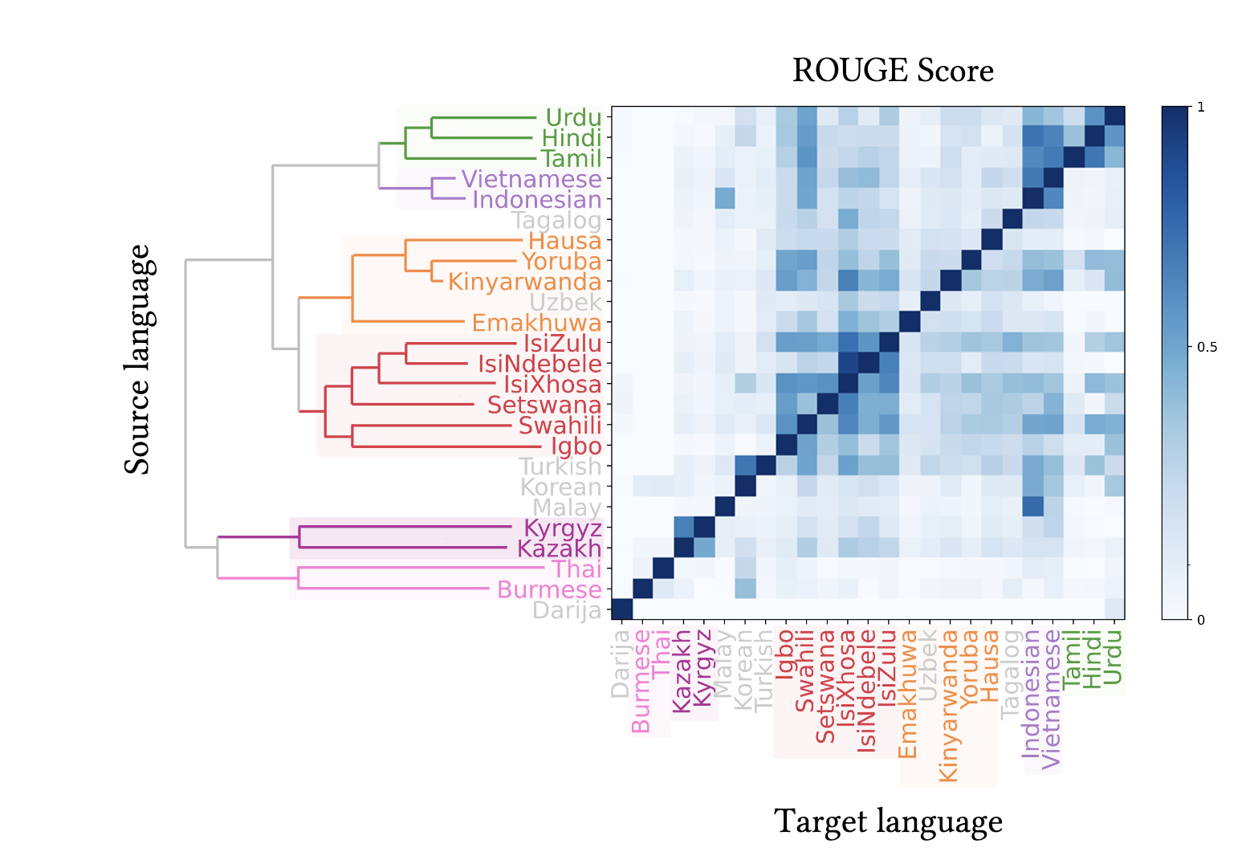

Slide 31
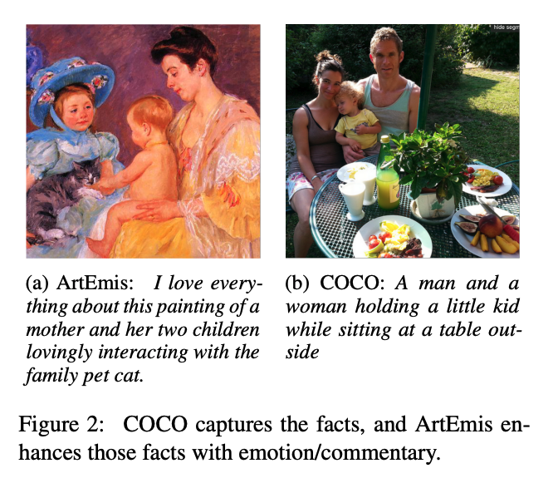
Adding Perspective to Speech/Vision Research COCO (Objective) → ArtEmis (Subjective)
Subjective Emotion
Objective
Facts
More room for Audience Background:
Culture/Language
Nouns: man, woman, kid, table
Modifiers: love, interacting, family
No Bounding Boxes

Slide 32
Agenda/Conclusions: Unifying Themes: Scaling, Growth & Collaboration Catch-as-catch-can → Revival of Sampling
Macro (Large Market Forces)
Micro (Personal Research)
Who can afford to play?
Narrative: Big companies with deep pockets
DeepSeek showed anyone can contribute
Clouds → Phones
Inference >> Training
“Diseconomies of scale”
Implications for global warming
Peak Data:
Scaling laws break down if we run out of data
Moore’s Law: Everything is getting better
but at different rates → need to rebalance
Should we be more concerned about
supply or demand?
Unify LLMs and Linear Algebra
SVD with Batching
Better Together
Academic Search
BERT Embeddings of Papers
Spectral Clustering of Citations
Loss Functions
Entropy: Predict the next word
Nuclear Norm: within → across
Low Resource Languages →
Growth Opportunities
Target languages with future demand
Many speakers and impressive GDP growth

Slide 33
My Current Research
Unify LLMs and Linear Algebra
SVD with Batching
Better Together
Academic Search
BERT Embeddings of Papers
Spectral Clustering of Citations
Loss Functions
Entropy: Predict the next word
Nuclear Norm: within → across
Low Resource Languages →
Growth Opportunities
Target languages with future demand
Many speakers and impressive GDP growth

Slide 34
backup

Slide 35
Enterprise → Consumer
I used to say I would not use a computer I could afford
But that was before my wife bought our first PC
I had to admit that her PC was better than the computer I wrote my thesis on
When I was in grad school,
the enterprise market was larger than the consumer market

Slide 36
Bottlenecks: Different time constants → Rebalancing
Talent:
Short term, Silicon Valley and American Universities
are the envy of the world
Longer-term, those advantages may not be sustainable
Data: Peak data
For a long time, the rising tide of data has been lifting all boats
But we are running out of data to train on
Focus on more sustainable data sources like DNA
Bandwidth is not improving as fast as disk
Clouds → Edge (Phones)
Storage (RAM, Disk, SSD): Supply is increasing faster than demand
We have never had to worry about demand in the past,
But that is likely to change
GPUs: Insanely profitable in short term, but may not be sustainable long-term

Slide 37
Bottlenecks
People
Data (Empiricism)
Bandwidth
Storage
CPUs
GPUs
Everything is getting better
But at different rates
In addition,
supply is increasing
faster than demand
Historically,
If we build it, they will come
But if everyone has more compute than they need
will they continue to come
Challenge:
find new killer apps
(so demand keeps up with supply)

Slide 38
Agenda: Unifying Theme → Scaling
Macro (Large Market Forces)
Micro (Personal Research)
Moore’s Law: Everything is getting better
but at different rates
Peak Data:
Scaling laws assume unlimited data
Language data: limited by population bound
Who can afford to play?
Narrative: Big companies with deep pockets
DeepSeek showed anyone can contribute
Clouds → Phones
Inference >> Training
“Diseconomies of scale”
Implications for global warming
Unify LLMs and Linear Algebra
SVD with Batching
Better Together
Academic Search
BERT Embeddings of Papers
Spectral Clustering of Citations
Loss Functions
Entropy: Predict the next word
Nuclear Norm: within → across
Low Resource Languages →
Growth Opportunities
Target languages with future demand
Many speakers and impressive GDP growth

Slide 39
Short Term
Longer Term
Huge demand for GPUs
Clouds
Inference → Phones
Edge

Slide 40
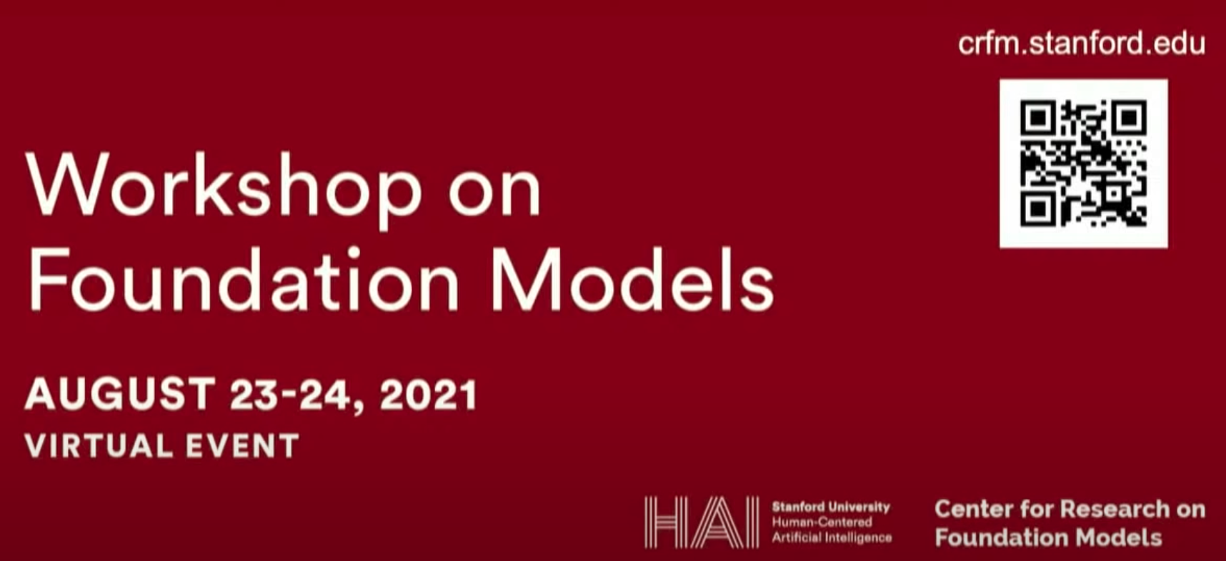
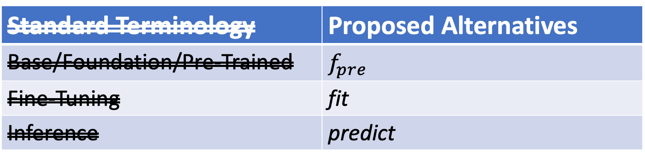
Why Change Terminology?
More opportunity for academics
Standard Terminology | Proposed Alternatives
Base/Foundation/Pre-Trained | $$f_{pre}$$
Fine-Tuning | fit
Inference | predict
Not this
Emphasize this
Emphasize this
https://www.youtube.com/watch?v=dG628PEN1fY
Industry has an unfair advantage over academia
Pre-training requires $$$$, Big Data & Logistics:
Big Investments → Risk Adverse → Less Creativity

Slide 41
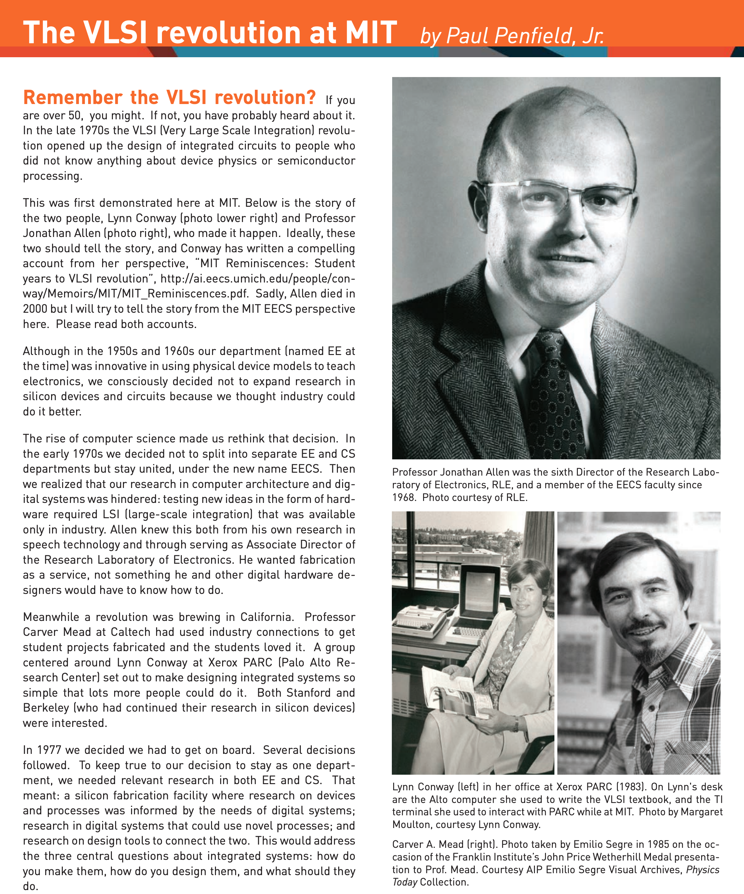
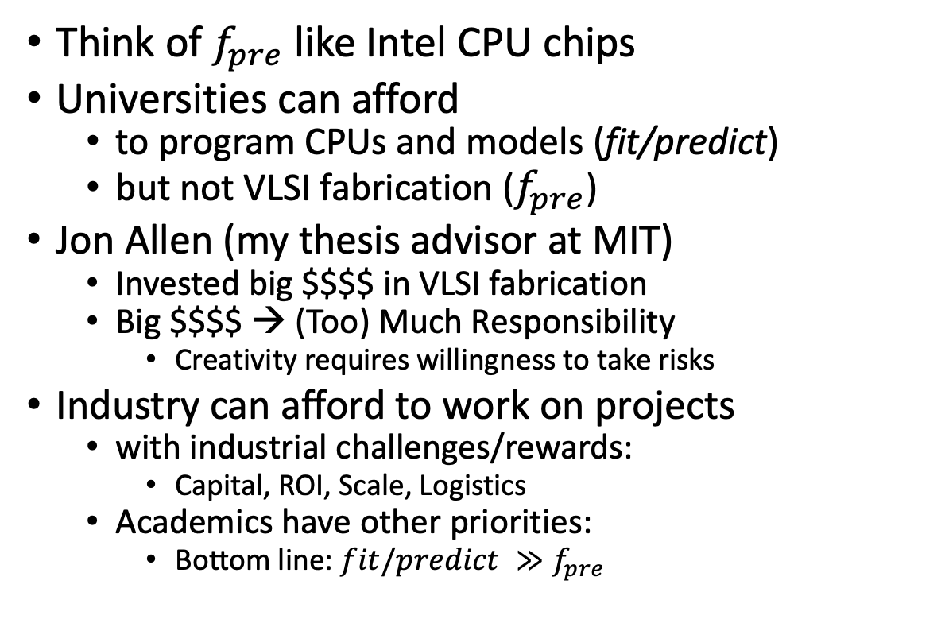
VLSI History http://www.eecs.mit.edu/docs/newsletter/VLSI.pdf http://ai.eecs.umich.edu/people/conway/Memoirs/MIT/MIT_Reminiscences.pdf
Perspective from MIT and beyond:
IBM, Silicon Valley, Mich, LGBTQ, etc.
Think of $f_{pre}$ like Intel CPU chips
Universities can afford
to program CPUs and models (fit/predict)
but not VLSI fabrication ($f_{pre}$)
Jon Allen (my thesis advisor at MIT)
Invested big $$$$ in VLSI fabrication
Big $$$$ → (Too) Much Responsibility
Creativity requires willingness to take risks
Industry can afford to work on projects
with industrial challenges/rewards:
Capital, ROI, Scale, Logistics
Academics have other priorities:
Bottom line: $fit/predict ≫f_{pre}$

